Slide 1

Necessary Spaces:
Using a phenomenology of the material to investigate school bathrooms
Kristidel McGregor
University of Oregon
Notes:
I’d like to begin with welcome and thanks. I am so appreciative of the chance to share my work with you all.
My current project is investigating the experience of school bathrooms. (reaction? Ad lib?)

Slide 2
Provocations:
The too strange is, however, the provocation, the knot, the world kicking back, the too much that demands experimentation. Inquiry should begin with the too strange and the too much.
St. Pierre, 2017
Material feminism provokes us to think of meanings as emergent within dynamic entanglements of all manner of elements.
Taylor, 2013
Notes:
Bathroom spaces are necessary – but provocative. School bathrooms are contested sites, a physical space where students’ social, material, and discursive worlds have ontological weight, where the material-discursive is felt in the body.
Bathrooms can provoke. These provocations have been helpful to my work – particularly when I was thinking about what theory I can think with to investigate this contested, complex space.

Slide 3
“Public and toilet do not sit well together, and the discord goes beyond words.”
~Molotch & Norén, 2010
Current reserach
not conducted in the United States, or was focused on the toilet training of small children (Kistner, 2009; Norling, Stenzelius, Ekman, & Wennick, 2016; Ramos, Blea, Trujillo, & Greenberg, 2010; Vernon, Lundblad, & Hellstrom, 2003).
Sociologists have conducted some inquiries on public toilets in general (Blumenthal, 2014; Horan, 1996; Molotch & Norén, 2010)
queer theorists and scholars of gender (Cavanagh, 2010; Gershenson & Penner, 2009; Ingrey, 2012; Wernick, Kulick, & Chin, 2017)
Notes:
As the book Toilet: Public Restrooms and the Politics of Sharing notes, the words “public and toilet do not sit well together, and the discord goes beyond words” (Molotch & Norén, 2010). This discord is even more present when the toilets in question are in schools.
While a few brave folks have done research on public school restrooms, most of it was not conducted in the United States, or was focused on the toilet training of small children.
Sociologists have conducted some inquiries on public toilets in general, as have queer theorists and scholars of gender, but educational researchers in the United States have, for the most part, averted their gaze from toilets and their effects on teaching and learning.
This is not because these spaces are insignificant. A brief investigation of publicly available information, gathered from social media and google news alerts, shows several areas of concern in and around school bathrooms. Access to school bathrooms is an ongoing civil rights issue, as can be seen in the experiences of students of color in both integrated and segregated school spaces over the past 100 years. Just two weeks ago, on May 8th, high school students in Stillwater, MN staged a bathroom sit in, protesting for their right to unlocked bathrooms.
Currently, bathrooms are sites of student misbehavior: bullying, smoking, “juuling” or using other substances, fires in the trash cans. Lawsuits and school boards furiously debate the rights of students to use the bathroom that matches their gender identity; recommendations from the United States Department of Education regarding toilet access are issued by one politician, and rescinded by another.

Slide 4
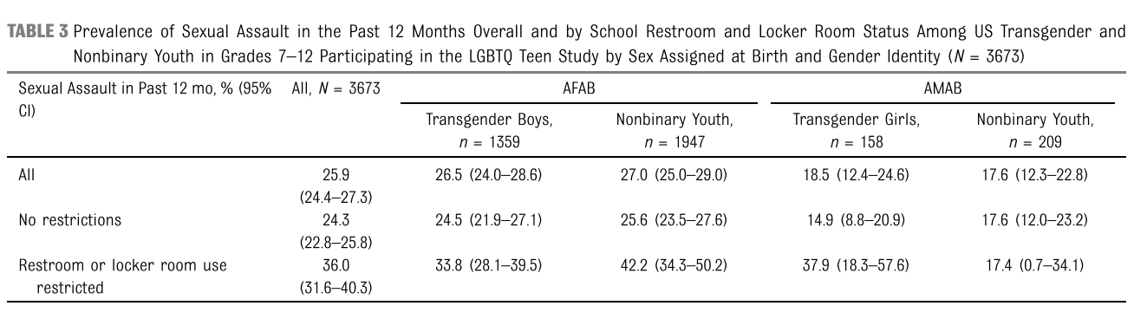
Murchison, G. R., Agénor, M., Reisner, S. L., & Watson, R. J. (2019). School Restroom and Locker Room Restrictions and Sexual Assault Risk Among Transgender Youth. Pediatrics, 143(6).
Notes:
But what I find to be the strongest provocation is that what happens in school bathrooms seems to be deeply linked to how our students experience schools. There are a lot of examples, but this is one I want to share you today..
This study came out this month in the journal Pediatrics. It’s a quantitative study, based on a survey of more than 3500 gender non-conforming youth in grades 7 – 12. They found that these students experience sexual assault at a much higher rate than their peers. Discuss slide.

Slide 5
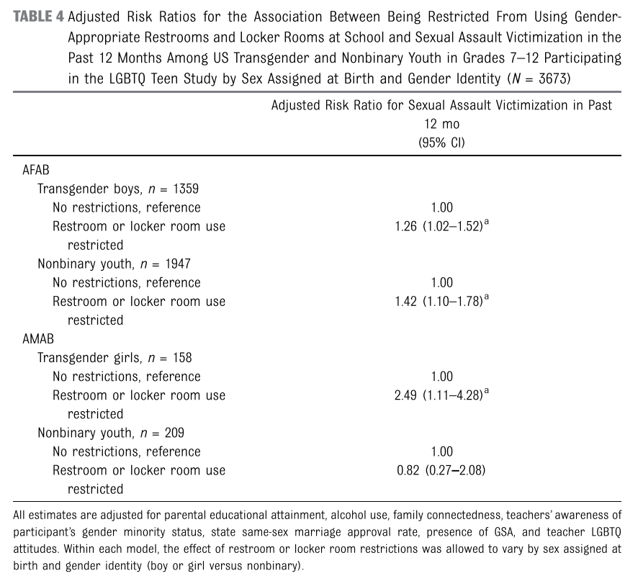
Murchison, G. R., Agénor, M., Reisner, S. L., & Watson, R. J. (2019). School Restroom and Locker Room Restrictions and Sexual Assault Risk Among Transgender Youth. Pediatrics, 143(6).
Youth subject to restroom and locker room restrictions had an overall sexual assault prevalence of 36.0% (95% CI: 31.6%–40.3%).
Notes:
Ultimately, an inescapable conclusion is that school policies matter. It also underscores the need to tread with care when designing a research project that seeks to understand students’ experiences of school bathrooms – clearly, there is much at stake.

Slide 6
Thinking Feminist Phenomenology with
New Materialisms
Mann describes a feminist phenomenology that must “give a meaningful account of politics and power, of the unfreedoms that structure our lives in heinous ways . . . yet to give account of these structures without attention to how we live them is to risk an equally abstract objectivism that can’t grasp the lived meaning of structural injustice” (Mann, 2009, p. 91).
Barad’s material feminist account argues that ‘bodies do not simply take their place in the world … rather “environments” and “bodies” are intra-actively constituted’ (Barad, 2007, pg. 170).
Notes:
I GROUND MY project in feminist phenomenology and new materialisms, which can seem like unlikely bedfellows. Betty St. Pierre would say that they are uncommensurable, which never fails to make me uncomfortable.
But when I think feminist phenomenology with and through new materialism, I find places of overlap and emphasis that are provocative, and when I allow that provocation to lead my inquiry I can, just maybe, end up in place where I can think the new.
The feminist phenomenological account is one of a lived, gendered, raced, classed, positioned body encountering a world shaped by discursive and structural forces. Feminist phenomenology is very much a critical realist practice: There is work to be done, and the political and material consequences of that work are manifested in lived bodies.
As Dr. Bonnie Mann describes, a feminist phenomenology must “give a meaningful account of politics and power, of the unfreedoms that structure our lives in heinous ways . . . yet to give account of these structures without attention to how we live them is to risk an equally abstract objectivism that can’t grasp the lived meaning of structural injustice” (Mann, 2009, p. 91). Feminist phenomenologists seek to explore how semiotic and discursive practices have material consequences, manifested in embodied, lived experiences, so they can recommend interventions to disrupt oppressive patriarchal practices. This quest to account for not just the shape of structural injustice, but how that injustice is lived is at the heart of feminist phenomenology, and is a key practice that helps articulate what is lost when we lose concrete phenomenological accounts of the real.
At the same time, school bathrooms strike me as an example of Bennet’s “lively matter.” As Barad says, bodies do not simply take their place in the world, but “environments” and bodies” are intra-actively constituted.
So what am I to make of the provocation I found in the “lively matter” of the school bathrooms? I don’t want to lose the account of embodied lived experiences, but I also want to consider those bodies in a new materialist lens so as not to discount or the role of the material in co-constituting what happens there.
An so, in this work, I attempt to theorize students’ experiences with school bathrooms within the framework of Barad’s onto-epistemology. Thinking with Barad, I see the school bathrooms at my study site as part of an intra-active phenomenon. Entangled within this phenomenon are human and non-human agents, the material world, and discursive and socio-cultural structures.

Slide 7
World as intra-active phenomena
The lively matter of the world—buildings, floors, books, animals, plants, people, the sounds of the train going by—is entangled. This entanglement is what Barad calls an ongoing intra-active phenomena, becoming not just a collection of things together, but an entanglement of relationships and shifting patterns of agentic forces. For Barad, individual subjectivity becomes eclipsed—We are not being-in-the- world so much as we are being-with-the-world. (McGregor 2019)
Notes:
As I was thinking about theory, I considered the possibilities of a phenomenology of the material in depth, and even wrote about it. But that’s what I’m here to talk to you about today.

Slide 8
Research using a phenomenology of the material acknowledges that when we reach into the phenomena it reaches back – the configuration we find is determined by the apparatus we construct to observe it. This momentary fixing of the intra-active phenomenon is not “discovering” something that was uncertain, it is defining something that was indeterminate.
For a phenomenology of the material, the a priori is not dismissed or bracketed, but the researcher must instead remind ourselves that there is no a priori – nothing exist independently, but is instead produced from and with a complex system of intra-active entanglement.
Notes:
Ultimately, our theory must come to practice – embodied theory to practice.
We have to focus our gaze somewhere – but with a care to not approaching the experience in an attempt to somehow “capture the moment,” or “uncover” a hidden truth. Research using a phenomenology of the material acknowledges that when we reach into the phenomena it reaches back – the configuration we find is determined by the apparatus we construct to observe it. This momentary fixing of the intra-active phenomenon is not “discovering” something that was uncertain, it is defining something that was indeterminate.
For a phenomenology of the material, the a priori is not dismissed or bracketed, but the researcher must instead remind ourselves that there is no a priori – nothing exist independently, but is instead produced from and with a complex system of intra-active entanglement.
Intra-active phenomena exist in a state of indeterminacy.
Our measurement fixes the phenomenon for a moment, and our measurement/documentation of one part of the phenomenon also determineds/fixes other, entangled parts of the phenomenon.
The phenomenological intent changes – the researcher is not an outside observer hoping to uncover the essence of a phenomenon, but instead must consider and accept the responsibilities that come with measurement.

Slide 9
As Dr. Jerry Rosiek and Katie Fitch said in their pre-conference workshop:
“’Entanglement isn’t just any relation, or a fancy way to say we are all connected. It is a specific kind of connection born of being part of a shared system governed by some rules, and an indeterminacy about exactly how those rules play out prior to being measured.”

Slide 10
How does theory-become-practice?
Intra-active phenomena of the school bathrooms at my study site exist in a state of indeterminacy – but it is also a phenomenon that has limits and rules.
When I set up an apparatus to measure this phenomenon, I am also fixing the thing that I measure – for this moment, it is no longer indeterminate, but determined. This fixing also has echoes throughout the phenomenon – this is the consequence of entanglement.
Notes:
Intra-active phenomena exist in a state of indeterminacy.
Our measurement fixes the phenomenon for a moment, and our measurement/documentation of one part of the phenomenon also fixes those things that are entangled with what we measure.

Slide 11
Research situation
Population is 128 eighth graders at a middle school, through their English Language Arts class.
When I conduct this research, I become a part of this phenomenon, and have ethical obligations.
What is “‘discovered’ is the effect of the intra-active engagement of (my) participation with/in and as a part of the world’s differential becoming” (Barad, 2007, p. 361)
Notes:
So all of this theory comes to rest on 128 8th graders and 3 gendered sets of bathrooms, and 2 recently designated gender neutral ones. They are 13 years old, and it their experiences that I am measuring.

Slide 12
Entanglement:
Ethics, ripples, and measurement
Every time I use an apparatus to measure the phenomenon, I am not just fixing what I measure but I’m all determining other points within the intra-active phenomenon. My acts of measurement ripple – as Barad says, the universe reaches back.
Notes:
The ethic of this kind of work is something I’m still grappling with. Every time I use an apparatus to measure the phenomenon, I am not just fixing what I measure but I’m all determining other points within the intra-active phenomenon. My acts of measurement ripple – as Barad says, the universe reaches back. This is what entanglement means – and although I myself have succumbed to the temptation to describe Baradian entanglement as a connection, or a relationship, it is also much more than that.

Slide 13
Multiple apparatuses
Photographs of the bathrooms
Photo sorting focus groups (creating categories)
Writing from photo prompts
Online survey
Notes:
I decided to set up multiple difference apparatuses to measure the phenomenon. As I was thinking through the research design, I didn’t think a single measurement would give me enough information to begin to understand the rules and forces that are at work within this phenomenon.
But I want to be clear that by measuring the phenomenon multiple times, I am not attempting a kind of triangulation, or seeking to determine some kind of “complete picture” of this particular intra-active phenomenon.
Instead, I’m hoping to get a sense of the moments, forces, agents, and rules that govern this particular phenomenon.

Slide 14
Some preliminary insights – data collection ended April 26th
Bathrooms as social space
Emphatic, aggressive, almost angry assertions that there is nothing to see
(in)visibility of the gender-neutral bathrooms

Slide 15

Thank you
Kristidel McGregor
University of Oregon
kristide@uoregon.edu

